Slide 1
Modular Arithmetic
Several important cryptosystems make use of modular arithmetic. This is when the answer to a calculation is always in the range 0 – m where m is the modulus.
To calculate the value of n mod m, you take away as many multiples of m as possible until you are left with an answer between 0 and m.

Slide 2
If n is a negative number then you add as many multiples of m as necessary to get an answer in the range 0 – m.
Examples
17 mod 5 = 2 7 mod 11 = 7
20 mod 3 = 2 11 mod 11 = 0
-3 mod 11 = 8 -1 mod 11 = 10
25 mod 5 = 0 -11 mod 11 = 0

Slide 3
Two numbers a and b are said to be “congruent modulo n” if
(a mod n) = (b mod n) → a ≡ b(mod n)
The difference between a and b will be a multiple of n
So a-b = kn for some value of k
E.g: 4 ≡9 ≡ 14≡19 ≡ -1 ≡ -6 mod 5
73 ≡ 4(mod 23); 21 ≡ -9(mod 10)
If a ≡ 0 (mod n), then n|a.

Slide 4
Properties of Congruences
a ≡ b (mod n) if n|(a-b)
a ≡ b (mod n) implies b ≡ a (mod n)
a ≡ b (mod n) and b ≡ c (mod n) imply a ≡ c (mod n)
Proof of 1.
If n|(a-b), then (a-b) = kn for some k. Thus, we can write
a = b + kn. Therefore,
(a mod n) = (remainder when b + kn is divided by n) = (remainder when b is divided by n) = (b mod n).

Slide 5
Examples
23 ≡ 8 (mod 5) because 23 -8 =15 = 5x3
-11 ≡ 5 (mod 8) because -11-5 =-16 = 8x(-2)
81 ≡ 0 (mod 27) because 81-0=81 = 27x3

Slide 6
Properties of Modular Arithmetic
[(a mod n) + (b mod n)] mod n = (a + b) mod n
[(a mod n) - (b mod n)] mod n = (a - b) mod n
[(a mod n) x (b mod n)] mod n = (a x b) mod n
Proof of 1.
Let (a mod n) = Ra and (b mod n) = Rb. Then, we can write
a = Ra + jn for some integer j and b = Rb + kn for some integer k.
(a + b) mod n = (Ra + jn + Rb + kn) mod n
= [Ra + Rb + (k + j) n] mod n
= (Ra + Rb) mod n
= [(a mod n) + (b mod n)] mod n

Slide 7
Examples
11 mod 8 = 3; 15 mod 8 = 7
[(11 mod 8 ) + (15 mod 8)] mod 8 = 10 mod 8 = 2
(11 + 15) mod 8 = 26 mod 8 = 2
[(11 mod 8 ) - (15 mod 8)] mod 8 = -4 mod 8 = 4
(11 - 15) mod 8 = -4 mod 8 = 4
[(11 mod 8 ) x (15 mod 8)] mod 8= 21 mod 8 = 5
(11 x 15) mod 8 = 165 mod 8 = 5

Slide 8
Modular Division
What is 5 ÷ 3 mod 11?
We need to multiply 5 by the inverse of 3 mod 11
When you multiply a number by its inverse, the answer is 1.
Thus the inverse of 2 is ½ since 2* ½ = 1
The inverse of 3 mod 11 is 4 since 3*4=1 mod 11
Thus 5 ÷ 3 mod 11 = 5*4 mod 11 = 9 mod 11

Slide 9
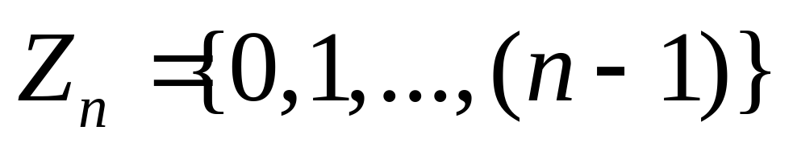
Properties of Modular Arithmetic
Define the set Z_{n} as the set of nonnegative integers less than n:
This set is referred to as the set of residues, or residue classes (mod n). That is, each integer in Zn represents a residue class.

Slide 10
Properties of Modular Arithmetic
We can label the residue classes (mod n) as:
[0],[1],[2],...,[n-1], where
[r] = {a: a is an integer, a ≡ r (mod n)}.
E.g.: The residue classes (mod 4) are
[0] = {..., -16,-12,-8,-4,0,4,8,12,16, ...}
[1] = {..., -15,-11,-7,-3,1,5,9,13,17, ...}
[2] = {..., -14,-10,-6,-2,2,6,10,14,18, ...}
[3] = {..., -13,-9,-5,-1,3,7,11,15,19, ...}

Slide 11
Properties of Modular Arithmetic
Property | Expression
Cummitative Laws | (w + x) mod n = (x + w) mod n (w x x) mod n = (x x w) mod n
Associative Laws | [(w + x) + y] mod n = [w + (x + y)] mod n [(w x x) x y] mod n = [w x (x x y)] mod n
Distributive Law | [w x (x + y)] mod n = [(w x x) + (w x y)] mod n
Identities | (0 + w) mod n = w mod n (1 x w) mod n = w mod n
Additive Inverse (-w) | For each w Z_{n}, there exists a z such that w + z ≡ 0 mod n

